Slide 1
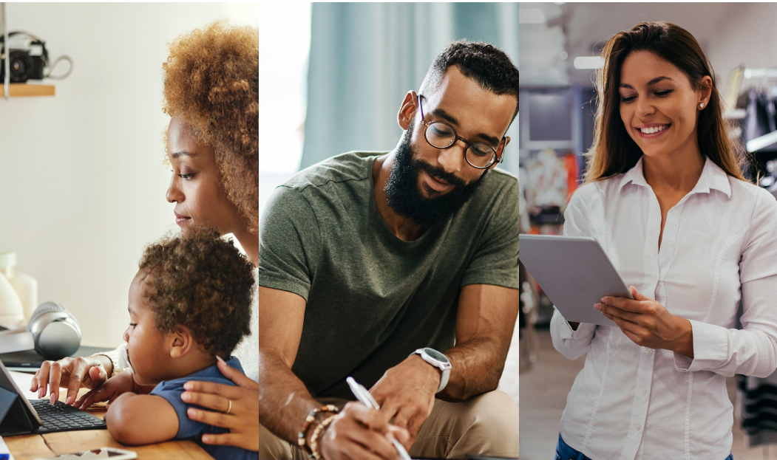
Quality Workforce Committee
Presented by
November 2022 (Q4)

Slide 2
ACRC Program Updates- Fall 2022
Additional companion assessment and skill development in Digital Literacy - foundational level available launched and trending
RFP issued/proposal offering closes Nov. 4th for 5-year continuation of full program - RFP process to be finalized by Jan. 2023
Q1 (Jul-Sep) 2022 - all data outpaced Q1 2021 - certs earned, hours in platform, meas. gains
Professional Skills certificate heavily trending with active partners
Some ARIZONA@WORK participation has improved since summer
AZ@WORK enrolled 450 vs. 2000 from other partners Jan-Oct ‘22

Slide 3
Apprenticeships
IRAPs and NGA Action Labs

Slide 4
Final Rule to Rescind the Industry Recognized Apprenticeship Program
Effective November 25, 2023
Direct all resources back to Registered Apprenticeships
Good Paying Jobs
Create reliable pathways
NGA Youth Apprenticeship Action Labs
October 26th and 27th
State representation- DES/OEO/EDU
Policy Landscape
Funding Mechanism
Next Steps

Slide 5
ADE Career Expo
Jobs in Education Industry

Slide 6
ARIZONA EDUCATION
JOB FAIR & CAREER EXPO
REGISTER TODAY
bit.ly/3ChPQob
NEW CAREER EXPO
ADE is partnering with education HR leaders to provide a Career
Expo as a resource for job seekers. Sessions will introduce the
benefits and career pathways available to those working in Arizona
schools. Workshops will provide tips for resumés and interview
practice.
February 4th
8:00 AM - 2:00 PM

Slide 7
AZ Quest Grant
Award and Overview

Slide 8
DOL National Dislocated Worker Grant
Arizona QUEST $15 million award
6 Local Workforce Development Areas
Cochise, Maricopa (City of Phoenix), Mohave/La Paz, Pima, Yavapai, and Yuma
1500 participants- Dislocated workers impacted by COVID-19
Industries
Healthcare, Manufacturing, Logistics, and Professional, Scientific and Technical Services
Grant focus
Partnerships and Outreach
Business Engagement
Employment and Training

Slide 9
Council Restructure
Committee Discussion

Slide 10
Proposed Council Structure Changes
National Governors Association
Best Practices
Challenges
Committees vs. Workgroups
Beginning 1st Quarter 2023
Effectiveness and Efficiency
Statewide Collaboration
Strategic Plan
Initiatives and Priorities
Compliance vs. Statewide Expectations and Impact

Slide 11
Draft Structure
***Additional Workgroups may be created as needed
Workforce Arizona Council
Implementation of Robust and Effective Workforce System
Executive Committee
Policy
WIOA Reauthorization
Compliance Approvals
Business
Education
Priority Populations
Work Based Learning
Broadband
Apprenticeships
CTE
STEM
Career Pathways
Apprenticeships
Youth
Digital Equity
Integrated Service Delivery
Research and Evaluation

Slide 12
Questions
&
Comments

