Slide 1
Executive Committee
February 2023

Slide 2
Workforce Arizona Council Membership
New Council Members:
Scott A Holman, Director, Human Resources - TSMC
Michelle Bolton, Government Relations Director - Intel
Daniel Witt, Head of State and Local Public Policy - Lucid
Shawn Hutchinson, Training Director - Phoenix Electrical
Workforce Vacancy
(2) Balance of Membership vacancies

Slide 3
Workforce Team Report
Sara Agostinho, Program Oversight and Support Administrator
Point of contact within the Department of Economic Security for information on or about the public workforce system
Coordinates federal and state workforce activities and technical assistance
Cultivates relationships with federal, state, and local partners and convenes cross-agency operational meetings
Email: sagostinho@azdes.gov

Slide 4
Workforce Team Report, cont’d
Projects and Events
WestMec
Broadband
STEM
Northern Arizona Research
ElevateEdAZ
Good Jobs Academy
2023 Arizona Workforce Summit
ACRC
Conferences
2023 NAWB Forum and Trailblazer Awards
2023 NGA Winter Symposium

Slide 5
Workforce Team Report, cont’d
2024-2027 Workforce Innovation and Opportunity Act (WIOA) State Plan
Planning and Gathering of Key Data: March-April 2023
Drafting by Contributors: May-August 2023
Drafting the Plan Document: September-October 2023
Public Comment: November 2023
Editing from Public Comment: December 2023-January 2024
WAC Review: February 2024
Finalizing - February 2024, after WAC approval
Routing (DES, Superintendent, Governor's office): February-March 2024
Submittal: March 15, 2024

Slide 6
Questions
&
Comments

Slide 7
Bylaws
Office of Economic Opportunity

Slide 8
Workforce Arizona Council Bylaws - Updates
Bylaws updates
Developed a new structure for the Executive Committee
Added in the election process for voting for officers
Added in positions of Vice Chair, Second Vice Chair, WIOA core title partners, and three additional members
Updated language to include creation of workgroups
Action: Vote to recommend approval of Bylaws at the Full Council meeting.

Slide 9
Council Policies
Overview & Update

Slide 10
WAC Policy Revisions Overview
5 policies for review and approval
Conflict of Interest
Brand Style Guide
MOU and IFA
WIOA Statewide Monitoring
Job Center Structure

Slide 11
Policy Overview
Conflict of Interest: establishes guidelines for conflict of interest, firewalls, and internal controls required under WIOA for Local Workforce Development Boards (LWDBs) and entities serving in more than one role in the ARIZONA@WORK system.
Was not released for public comment because no significant changes were made
Updated to renumber a policy and add a citation
Reviewed to ensure policy was in alignment with WIOA and AZ regulations

Slide 12
Policy Overview
Brand Style Guide: provides the information and direction, required under WIOA,regarding how Arizona’s workforce system stakeholders must use the ARIZONA@WORK brand
Public comment changes:
Updated policy to include Arizona Department of Education in the scope
Added in reference “In Arizona One-Stop partners are referred to as ARIZONA@WORK partners”
Added in clarifying language to ensure partners use branding appropriately

Slide 13
Policy Overview
MOU and IFA: provides Local Workforce Development Boards (LWDBs) and other workforce system partners instruction and guidance regarding the administration of ARIZONA@WORK Job Center Service Delivery system.
Public comment changes:
Amended to add in comprehensive language regarding the agreement developed between the LWDB, one-stop partners, and CEO relating to overall operation of the one-stop delivery system in the local area.
Amended language to include the following language: “Methods to ensure all partners of the MOU/IFA comply with the agreed upon initiatives, processes, procedures and vision as defined by the local workforce development board"

Slide 14
Policy Overview
WIOA Statewide Monitoring Policy: To establish roles of the Workforce Arizona Council (Council), the Arizona Department of Education (ADE) and the Arizona Department of Economic Security (DES), in ensuring compliance with WIOA and its regulations, Workforce Arizona Council policies, and WIOA implementation as outlined in the Arizona State Workforce Development Plan (State Plan). Monitoring information is used to inform the Council about the ARIZONA@WORK systems’ current status and support the Council in fulfilling its statutorily- defined strategic objectives
Public comment changes:
Adding in clarifying language regarding DES and ADE monitoring
Updated references

Slide 15
Policy Overview
Job Center Structure: provides Local Workforce Development Boards (LWDBs) and other workforce system partners with instruction and guidance regarding the structure and administration of ARIZONA@WORK Job Center and Service Delivery system.
Public comment changes:
Added clarifying language regarding job center and one-stop system
Added clarifying information on career pathways
Added clarifying language regarding electronic delivery and in-person services
Action: Vote to recommend approval of 5 policies at the Full Council meeting.

Slide 16
Council Elections
Election Process & Nominations

Slide 17
Election Process
Developed new structure for the Executive Committee in the Bylaws
Added election process
Added positions of Vice Chair, Second Vice Chair, WIOA core title partners, and three additional members selected by the Chair
Officers elected for a three year term
Seats to be filled during the election: Vice Chair and Second Vice Chair
Positions must be filled by business members to comply with WIOA
Elections occur at the first regularly scheduled meeting of each calendar year (as needed or if a vacancy occurs).
Elections will be held at Full Council meeting on 2/23/23

Slide 18
Election Process
Vice Chair: Vice Chair will perform the Chair’s duties in the event of the Chair’s absence at meetings or in such circumstances where the Chair will relinquish duties to the Vice-Chair
Second Vice Chair: In the absence of the Council Chair and Vice Chair, the Second Vice Chair will perform all duties of the Chair.
Questions?

Slide 19
Local Plan Modifications
2020 - 2024

Slide 20
Local Plan Modifications Update
Coconino County
11/29/22: Conditionally Approved by Full Council, pending CEO approval
12/6/22: Coconino County BOS Approved Final Draft Plan Modification
Northeastern Arizona
11/29/22: Council voted to approve second extension request with deadline of 12/31/22.
12/13/22: Navajo County BOS (Local CEO) Approved Final Draft Plan Modification
Nineteen Tribal Nations
Request for Extension: Deadline of 3/10/2023
Action Item: Vote to recommend approval of completed Local Plan Modifications and Request for Extension at the Full Council meeting.

Slide 21
Local Workforce Development Board
Yavapai WDB

Slide 22
Yavapai Workforce Development Board (WDB) - Request to Extend NACOG Contract
WDB contracted with the Northern Arizona Council of Governments (NACOG) as the One-Stop Operator (OSO) and Service Provider for Adult, Youth, and Dislocated Worker funds. The staff providing these services are employed by NACOG.
The WDB staff is also also employed by NACOG
Per the WIOA regulations and Council’s Local Governance Policy, LWDBs may be designated as the OSO and Service Provider, with approval from the Workforce Arizona Council

Slide 23
Yavapai Workforce Development Board (WDB) - Request to Extend NACOG Contract
The original contract between NACOG and the WDB ended on 6/30/22.
The WDB requested and was granted an extension until 12/31/22 by DES due to a health emergency with the WDB’s consultant to allow time to conduct a competitive procurement to select an OSO.
In late November, the WDB requested another extension of the current contract due to the fact that they had conducted two competitive procurements which were closed with no responses.
DES responded by agreeing to allow the extension of the contract with NACOG through 3/31/23, on the condition that the WDB provide DES with an implementation plan on how the WDB intends to conduct a competitive procurement to resolve this matter.

Slide 24
Yavapai Workforce Development Board (WDB) - Request to Extend NACOG Contract
The WDB submitted an Implementation Plan which includes the following:
Extend the current contract with NACOG to ensure continuation of WIOA services in Yavapai County
Open a Request for Proposal (RFP) on 3/1/23 with responses due 4/1/23
After approval by the WDB and Yavapai County Board of Supervisors of a proposal submitted in response to the RFP, negotiate a new agreement no later than 5/31/23, for services to begin 7/1/23.
DES agrees with this Implementation Plan which involves continuing the OSO agreement with NACOG until 6/30/23.
As NACOG is staff to the WDB, DES is requesting Council approval for this extension.
Action Item: Vote to move the approval for the Request for Extension at the Full Council meeting.

Slide 25
Statewide Performance
Statewide Performance Update

Slide 26
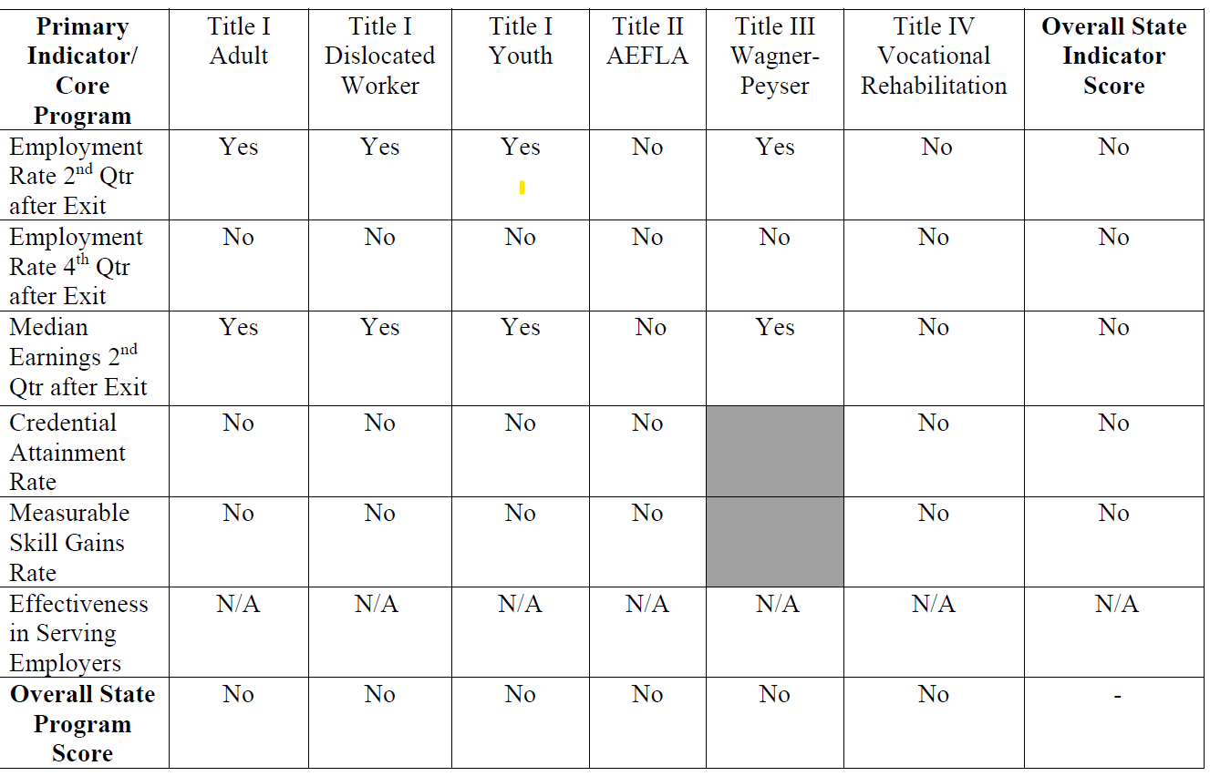
Notes:
Eventually all core programs must meet 6 primary indicators with a score of 50% or above, and have an overall program score at 90% or above and a overall state indicator score at 90% or above.; However, due to the impact of COVID and continued issues with how performance is to be assessed at the national level, DOL and DOE notified states in October 2021 that for PY2020 (year ending 6/30/21) and PY 21 (year ending 6/30/22), they would only assess Title I (adult, dw, and youth) and Title III (WP\ES) and only two primary indicators shown here, the Employment Rate 2nd Quarter After Exit and Median Earnings 2nd Quarter After Exit, would be assessed to determine if the state met performance.

Slide 27
Sanctions for Failure to Meet Adjusted Levels of Performance
For PY21, DOL determined a performance failure occurs if:
Specific single Individual Indicator Score for any single program for Title I (adult, dislocated worker and youth) or Title III (Employment Services) falls below 50 percent of the adjusted level of performance;
In the future, the assessment will include the single Individual Indicator Scores for all Titles and:
The Overall State Program Score falls below 90 percent for that single core program; or
The Overall State Indicator Score falls below 90 percent for that single measure.
Notes:
To meet Performance, DOL and DOE were to assess three items: Each individual indicator score must be 50% or above. In the future, all core programs will be assessed

Slide 28
Assessment of State Performance PY2021
DOL Assessed State Performance for PY2021 (7/1/2021-6/30/2022)
The following Individual Indicator Scores must be 50% or higher
Employment Rate 2nd Quarter After Exit
Adults
Dislocated Workers
Youth
Wagner-Peyser (Employment Service)
Median Earnings 2nd Quarter After Exit
Adults
Dislocated Workers
Youth
Employment Service (Wagner-Peyser)
Notes:
So for PY2020 and PY2021, there is no assessment of MSG for Title I as originally planned at the beginning of 2020

Slide 29
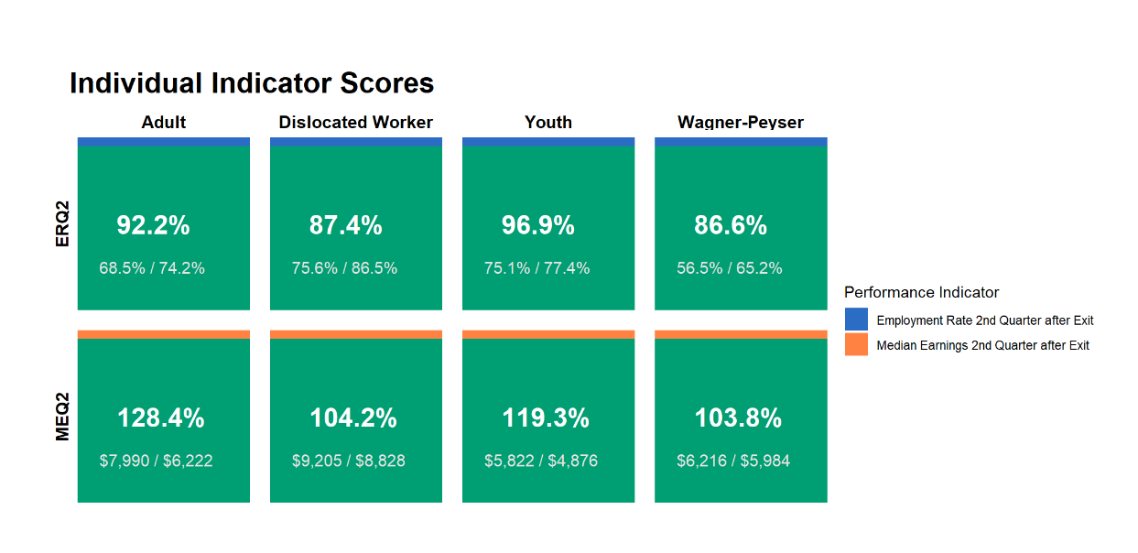
How Did Arizona Perform in PY2021?
Notes:
So how did Arizona do? The top number in each box represents the actual score. The number on the bottom left is the actual performance and the number in the bottom right is the negotiated adjusted level, which the model used by DOL says is performance the state is expected to achieve.
The green boxes indicate that the state met all indicators assessed for PY 2021. Scores in all categories were at or above 50%
It also should be noted that all states met indicators in PY2021?

Slide 30
Next Steps
Assess the Performance of the Local Workforce Development Boards (LWDBs) to Determine if LWDBs Met Performance for PY 2021 - required per TEGL 11-19
Assessment to be conducted as soon as data is available
Will Use the Same Indicators Used by DOL to Assess the State Performance to Assess (LWDBs) - scores must be 50% or higher for the following:
Employment Rate 2nd Quarter After Exit
Adults
Dislocated Workers
Youth
Median Earnings 2nd Quarter After Exit
Adults
Dislocated Workers
Youth
Notes:
What’s next?
DES and OEO currently reviewing local performance and the SAM tool used in 2020 to assess each local area in the same manner as DOL assessed the State. This next step is for Title I only, as there was no local negotiations for Title III. The programs under Title II and IV were not assessed in PY20 and will not be assessed in PY21. Also, Title I comprises 6 of the 8 measures assessed by DOL and when all core programs are assessed, Title I will impact over 51% of the measures to be assessed.

Slide 31
Workgroup Updates
Strategic Plan Workgroup

Slide 32
Strategic Plan Workgroup Update
Purpose of Workgroup
Workgroup Structure
LWDBs, DES, Council members, Titles I, II, III, IV, Business Services
Weekly meetings
OLD Workforce Arizona Council Mission & Vision Statement
Mission: The mission of the Workforce Arizona Council is to create meaningful linkages between the education and workforce systems, and help Arizonans of all backgrounds gain employment and prosper in a rapidly changing economy
Vision: The vision of the Workforce Arizona Council is to build a pro-growth economy that provides opportunity for all and builds prosperous communities by building the skills and abilities of Arizonans to meet the workforce needs of our employers

Slide 33
Strategic Plan Workgroup, cont’d
REVISED Workforce Arizona Council Mission & Vision Statement
Mission: To develop and support an equitable workforce system that connects business, education, and job seekers that results in a healthy (prosperous) economy in Arizona.
Vision: To create a future where every Arizonan has the opportunity to reach their full potential through access to meaningful employment and fulfilling careers, driving the economic growth and prosperity of our communities.
Action Item: Vote to move for the approval of the proposed Mission Statement and Vision Statement to the Full Council.

Slide 34
Labor Market In-Demand Industries
Rachael Tashbook, OEO
Kennedy Riley, OEO

Slide 35
What does ‘In-Demand’ mean?
Industry sector that has a substantial current or potential impact (including through jobs that lead to economic self-sufficiency and opportunities for advancement) on the state, regional, or local economy, as appropriate, and that contributes to the growth or stability of other supporting businesses, or the growth of other industry sectors.
WIOA Section 3(23)
The determination of whether an industry sector or occupation is in-demand under this paragraph shall be made by the State board or local board, as appropriate, using State and regional business and labor market projections, including the use of labor market information.
WIOA Section 3(23)(B)
Why does this matter to the State Workforce Council?

Slide 36
Why are In-Demand industries important?
Determine workforce board membership
Focus statewide employer engagement efforts
Support development of targeted career pathways for all WIOA programs’ participants
Determine industries of focus for the development and expansion of strategies to meet the needs of employers, workers, and job seekers particularly through industry or sector partnerships

Slide 37
Strategic Plan Workgroup Recommendations
Construction
Finance & Insurance
Health care and social assistance
Transportation and warehousing
Manufacturing
Information Technology
Retail
Which industries should be brought to the Full Council on February 23rd to be voted on as the PY2024-2027 In-Demand Industries?
Today’s Decision Item

Slide 38
Workforce Arizona Council Agenda
Council Agenda

Slide 39
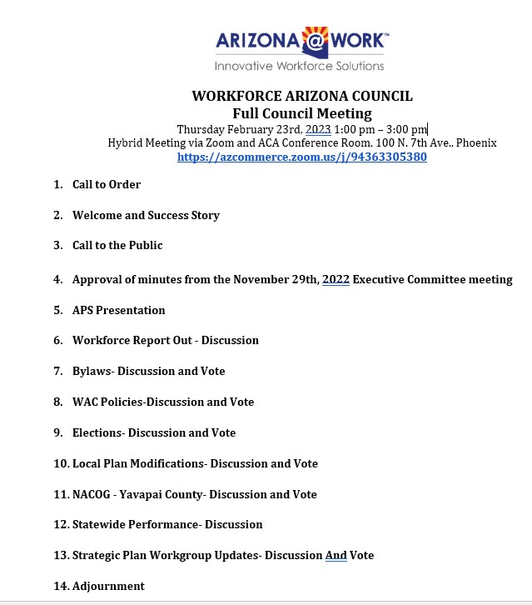

Slide 40
Questions
&
Comments

